Slide 1
雅思无忧直播课程-阅读
第四讲
主讲老师：朱峰

Slide 2
第四讲教学计划
困扰大家很久的问题，怎样分清楚False和Not Given
今天的内容将完全围绕着这一问题从以下四点展开
1、判断题的类型辨析
2、判断题的定位原理及重要性
3、判断题的考点分析
4、几个固定思维模式及概率分析

Slide 3
考完了，才想起来问老师的问题
考试时我把True写成T给不给分？写成Ture给不给分？
我判断题来不及做了，答案全都蒙成True给不给分？
True和Yes有区别吗，答案写混了怎么办？

Slide 4
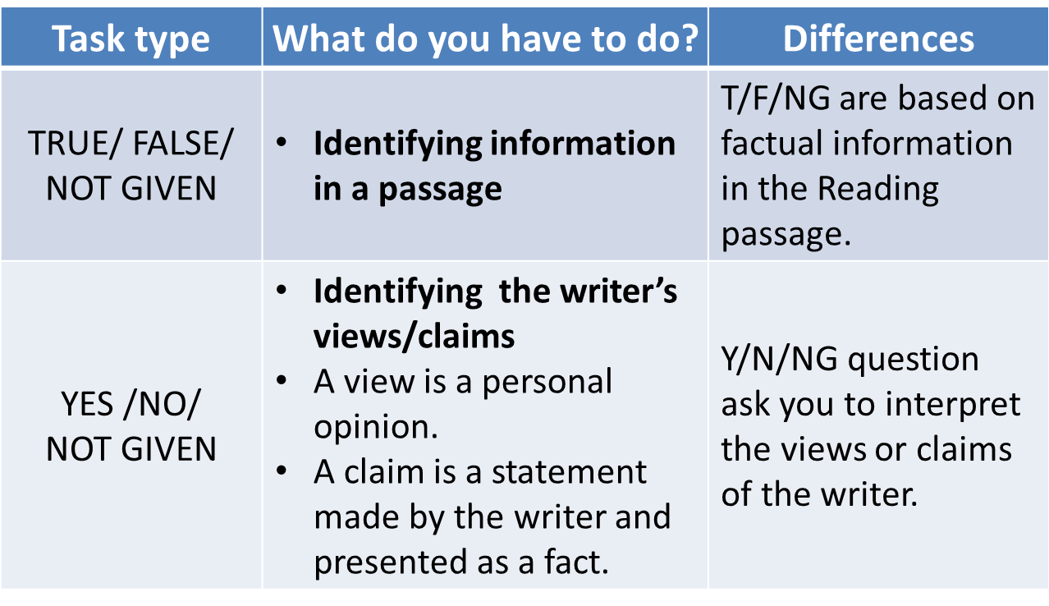
判断题的类型还有区别？

Slide 5
先试着定定位置
27 Environmentalists take a pessimistic view of the world for a number of reasons. true
28 Data on the Earth’s natural resources has only been collected since 1972. NG
29 The number of starving people in the world has increased in recent years. False
30 Extinct species are being replaced by new species. False
31 Some pollution problems have been correctly linked to industrialisation. False
32 It would be best to attempt to slow down economic growth.（C5P26） False

Slide 6
先试着定定位置
27 Environmentalists take a pessimistic view of the world for a number of reasons.
28 Data on the Earth’s natural resources has only been collected since 1972.
29 The number of starving people in the world has increased in recent years.
30 Extinct species are being replaced by new species.
31 Some pollution problems have been correctly linked to industrialisation.
It would be best to attempt to slow down economic growth.（C5P26）
思考三连：是不是按顺序，是不是局部出题，是不是每个题都有对应句

Slide 7
判断题的操作步骤
1、定位
必须先把所有题都定位完再做（不要定一题做一题）
按顺序出题（不必要按顺序找，从简到难的顺序定位）
一题对一句（不推断不概括，找到后标上题号）
每题至少划两组定位词（每题至少有一个原词）

Slide 8
判断题的操作步骤
定位是第一要务，绝大多数做错的判断题，都是因为定错了位置而出错
原文：这个方法经过了多次改进。
因为科学家们意识到一开始的做法是错误的。
问题：这个方法一开始是错误的

Slide 9
32 For the earliest tribes, the concept of sufficiency was more important than the concept of quantity.
33 Indigenous Tasmanians used only four terms to indicate numbers of objects.
34 Some peoples with simple number systems use body language to prevent misunderstanding of expressions of number.
35 All cultures have been able to express large numbers clearly.
36 The word ‘thousand' has Anglo-Saxon origins.
37 In general, people in seventh-century Europe had poor counting ability.
38 In the Tsimshian language, the number for long objects and canoes is expressed with the same word.
39 The Tsimshian language contains both older and newer systems of counting.
40 Early peoples found it easier to count by using their fingers rather than a group of pebbles.

Slide 10
32 For the earliest tribes, the concept of sufficiency was more important than the concept of quantity.
33 Indigenous Tasmanians used only four terms to indicate numbers of objects.
It is impossible to learn the sequence of events that led to our developing the concept of number. Even the earliest of tribes had a system of numeration that, if not advanced, was sufficient for the tasks that they had to perform. Our ancestors had little use for actual numbers; instead their considerations would have been more of the kind Is this enough? rather than How many? when they were engaged in food gathering, for example. （C6P51）

Slide 11
33 Indigenous Tasmanians used only four terms to indicate numbers of objects.
34 Some peoples with simple number systems use body language to prevent misunderstanding of expressions of number.
However, when early humans first began to reflect on the nature of things around them, they discovered that they needed an idea of number simply to keep their thoughts in order. As they began to settle, grow plants and herd animals, the need for a sophisticated number system became paramount . It will never be known how and when this numeration ability developed, but it is certain that numeration was well developed by the time humans had formed even semi­-permanent settlements.

Slide 12
33 Indigenous Tasmanians used only four terms to indicate numbers of objects.
34 Some peoples with simple number systems use body language to prevent misunderstanding of expressions of number.
Evidence of early stages of arithmetic and numeration can be readily found. The indigenous peoples of Tasmania were only able to count one, two, many; those of South Africa counted one, two, two and one, two twos, two twos and one, and so on. But in real situations the number and words are often accompanied by gestures to help resolve any confusion.

Slide 13
34 Some peoples with simple number systems use body language to prevent misunderstanding of expressions of number.
35 All cultures have been able to express large numbers clearly.
For example, when using the one, two, many type of system, the word many would mean, Look at my hands and see how many fingers I am showing you. This basic approach is limited in the range of numbers that it can express, but this range will generally suffice when dealing with the simpler aspects of human existence.

Slide 14
35 All cultures have been able to express large numbers clearly.
36 The word 'thousand' has Anglo-Saxon origins.
The lack of ability of some cultures to deal with large numbers is not really surprising. European languages, when traced back to their earlier version, are very poor in number words and expressions. The ancient Gothic word for ten, tachund, is used to express the number 100 as tachund tachund.

Slide 15
36 The word 'thousand' has Anglo-Saxon origins.
37 In general, people in seventh-century Europe had poor counting ability.
By the seventh century, the word teon had become interchangeable with the tachund or hund of the Anglo-Saxon language, and so 100 was denoted as hund teontig, or ten times ten. The average person in the seventh century in Europe was not as familiar with numbers as we are today. In fact, to qualify as a witness in a court of law a man had to be able to count to nine!

Slide 16
38 In the Tsimshian language, the number for long objects and canoes is expressed with the same word.
39 The Tsimshian language contains both older and newer systems of counting.
Perhaps the most fundamental step in developing a sense of number is not the ability to count, but rather to see that a number is really an abstract idea instead of a simple attachment to a group of particular objects. It must have been within the grasp of the earliest humans to conceive that four birds are distinct from two birds; however, it is not an elementary step to associate the number 4, as connected with four birds, to the number 4, as connected with four rocks.

Slide 17
38 In the Tsimshian language, the number for long objects and canoes is expressed with the same word.
39 The Tsimshian language contains both older and newer systems of counting.
Associating a number as one of the qualities of a specific object is a great hindrance to the development of a true number sense. When the number 4 can be registered in the mind as a specific word, independent of the object being referenced, the individual is ready to take the first step toward the development of a notational system for numbers and, from there, to arithmetic.

Slide 18
38 In the Tsimshian language, the number for long objects and canoes is expressed with the same word.
39 The Tsimshian language contains both older and newer systems of counting.
Traces of the very first stages in the development of numeration can be seen in several living languages today. The numeration system of the Tsimshian language in British Columbia contains seven distinct sets of words for numbers according to the class of the item being counted: for counting flat objects and animals, for round objects and time, for people, for long objects and trees, for canoes, for measures, and for counting when no particular object is being numerated.

Slide 19
38 In the Tsimshian language, the number for long objects and canoes is expressed with the same word.
39 The Tsimshian language contains both older and newer systems of counting.
It seems that the last is a later development while the first six groups show the relics of an older system. This diversity of number names can also be found in some widely used languages such as Japanese.

Slide 20
Intermixed with the development of a number sense is the development of an ability to count. Counting is not directly related to the formation of a number concept because it is possible to count by matching the items being counted against a group of pebbles, grains of corn, or the counter's fingers. These aids would have been indispensable to very early people who would have found the process impossible without some form of mechanical aid.
40 Early peoples found it easier to count by using their fingers rather than a group of pebbles.

Slide 21
判断题的操作步骤
2、对应
通读题干句和原文句 “不、反、错”=False “没”=Not Given

Slide 22
For many environmentalists, the world seems to be getting worse.
Environmentalists take a pessimistic view of the world for a number of reasons.

Slide 23
First, energy and other natural resources have become more abundant, not less so, since the book 'The Limits to Growth' was published in 1972 by a group of scientists.
Data on the Earth's natural resources has only been collected since 1972.

Slide 24
Second, more food is now produced per head of the world's population than at any time in history. Fewer people are starving.
The number of starving people in the world has increased in recent years.

Slide 25
Third, although species are indeed becoming extinct, only about 0.7% of them are expected to disappear in the next 50 years, not 25-50%, as has so often been predicted.
Extinct species are being replaced by new species.

Slide 26
And finally, most forms of environmental pollution either appear to have been exaggerated, or are transient—associated with the early phases of industrialisation and therefore best cured not by restricting economic growth, but by accelerating it.
Some pollution problems have been correctly linked to industrialisation.

Slide 27
And finally, most forms of environmental pollution either appear to have been exaggerated, or are transient—associated with the early phases of industrialisation and therefore best cured not by restricting economic growth, but by accelerating it.
It would be best to attempt to slow down economic growth.

Slide 28
判断题的操作步骤
2、对应
通读题干句和原文句 “不、反、错”=False “没”=Not Given
以考点词为主要验证点
程度adv 范围prep pron 趋势v adj 关系conj （因果 目的 比较）

Slide 29
32 For the earliest tribes, the concept of sufficiency was more important than the concept of quantity.
33 Indigenous Tasmanians used only four terms to indicate numbers of objects.
It is impossible to learn the sequence of events that led to our developing the concept of number. Even the earliest of tribes had a system of numeration that, if not advanced, was sufficient for the tasks that they had to perform. Our ancestors had little use for actual numbers; instead their considerations would have been more of the kind Is this enough? rather than How many? when they were engaged in food gathering, for example.

Slide 30
33 Indigenous Tasmanians used only four terms to indicate numbers of objects.
34 Some peoples with simple number systems use body language to prevent misunderstanding of expressions of number.
However, when early humans first began to reflect on the nature of things around them, they discovered that they needed an idea of number simply to keep their thoughts in order. As they began to settle, grow plants and herd animals, the need for a sophisticated number system became paramount . It will never be known how and when this numeration ability developed, but it is certain that numeration was well developed by the time humans had formed even semi­-permanent settlements.

Slide 31
33 Indigenous Tasmanians used only four terms to indicate numbers of objects.
34 Some peoples with simple number systems use body language to prevent misunderstanding of expressions of number.
Evidence of early stages of arithmetic and numeration can be readily found. The indigenous peoples of Tasmania were only able to count one, two, many; those of South Africa counted one, two, two and one, two twos, two twos and one, and so on. But in real situations the number and words are often accompanied by gestures to help resolve any confusion.

Slide 32
34 Some peoples with simple number systems use body language to prevent misunderstanding of expressions of number.
35 All cultures have been able to express large numbers clearly.
For example, when using the one, two, many type of system, the word many would mean, Look at my hands and see how many fingers I am showing you. This basic approach is limited in the range of numbers that it can express, but this range will generally suffice when dealing with the simpler aspects of human existence.

Slide 33
35 All cultures have been able to express large numbers clearly.
36 The word 'thousand' has Anglo-Saxon origins.
The lack of ability of some cultures to deal with large numbers is not really surprising. European languages, when traced back to their earlier version, are very poor in number words and expressions. The ancient Gothic word for ten, tachund, is used to express the number 100 as tachund tachund.

Slide 34
36 The word 'thousand' has Anglo-Saxon origins.
37 In general, people in seventh-century Europe had poor counting ability.
By the seventh century, the word teon had become interchangeable with the tachund or hund of the Anglo-Saxon language, and so 100 was denoted as hund teontig, or ten times ten. The average person in the seventh century in Europe was not as familiar with numbers as we are today. In fact, to qualify as a witness in a court of law a man had to be able to count to nine!

Slide 35
38 In the Tsimshian language, the number for long objects and canoes is expressed with the same word.
39 The Tsimshian language contains both older and newer systems of counting.
Perhaps the most fundamental step in developing a sense of number is not the ability to count, but rather to see that a number is really an abstract idea instead of a simple attachment to a group of particular objects. It must have been within the grasp of the earliest humans to conceive that four birds are distinct from two birds; however, it is not an elementary step to associate the number 4, as connected with four birds, to the number 4, as connected with four rocks.

Slide 36
38 In the Tsimshian language, the number for long objects and canoes is expressed with the same word.
39 The Tsimshian language contains both older and newer systems of counting.
Associating a number as one of the qualities of a specific object is a great hindrance to the development of a true number sense. When the number 4 can be registered in the mind as a specific word, independent of the object being referenced, the individual is ready to take the first step toward the development of a notational system for numbers and, from there, to arithmetic.

Slide 37
38 In the Tsimshian language, the number for long objects and canoes is expressed with the same word.
39 The Tsimshian language contains both older and newer systems of counting.
Traces of the very first stages in the development of numeration can be seen in several living languages today. The numeration system of the Tsimshian language in British Columbia contains seven distinct sets of words for numbers according to the class of the item being counted: for counting flat objects and animals, for round objects and time, for people, for long objects and trees, for canoes, for measures, and for counting when no particular object is being numerated.

Slide 38
38 In the Tsimshian language, the number for long objects and canoes is expressed with the same word.
39 The Tsimshian language contains both older and newer systems of counting.
It seems that the last is a later development while the first six groups show the relics of an older system. This diversity of number names can also be found in some widely used languages such as Japanese.

Slide 39
40 Early peoples found it easier to count by using their fingers rather than a group of pebbles.
Intermixed with the development of a number sense is the development of an ability to count. Counting is not directly related to the formation of a number concept because it is possible to count by matching the items being counted against a group of pebbles, grains of corn, or the counter's fingers. These aids would have been indispensable to very early people who would have found the process impossible without some form of mechanical aid.

Slide 40
判断题的概率统计：
剑10 T17 F15 NG18
剑11 T18 F14 NG12
剑12 T12 F14 NG10
剑13 T11 F12 NG9
剑14 T17 F15 NG12
剑15 T10 F11 NG9
剑16 T20 F17 NG13
剑17 T13 F18 NG15

Slide 41
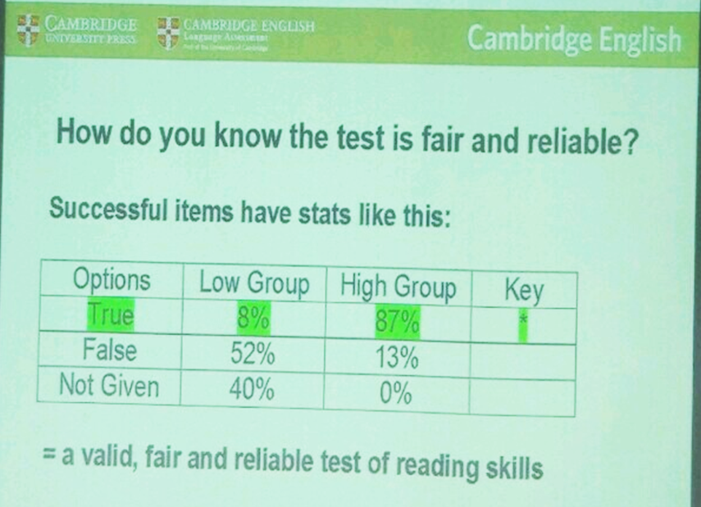

Slide 42
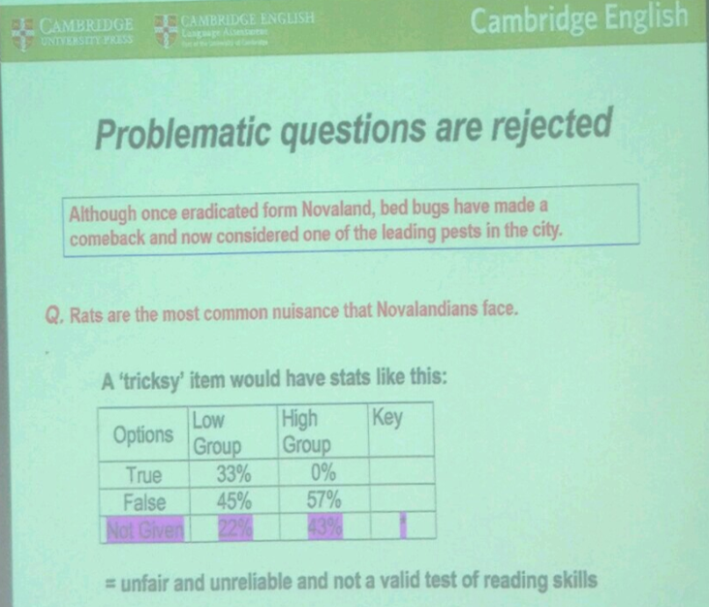

Slide 43
21 Water use per person is higher in the industrial world than it was in Ancient Rome.
22 Feeding increasing populations is possible due primarily to improved irrigation systems.
23 Modern water systems imitate those of the ancient Greeks and Romans.
24 Industrial growth is increasing the overall demand for water.
25 Modern technologies have led to a reduction in domestic water consumption.
26 In the future, governments should maintain ownership of water infrastructures.（C7P25）

Slide 44
A The history of human civilisation is entwined with the history of the ways we have learned to manipulate water resources. As towns gradually expanded, water was brought from increasingly remote sources, leading to sophisticated engineering efforts such as dams and aqueducts. At the height of the Roman Empire, nine major systems, with an innovative layout of pipes and well-built sewers, supplied the occupants of Rome with as much water per person as is provided in many parts of the industrial world today.

Slide 45
B During the industrial revolution and population explosion of the 19th and 20th centuries, the demand for water rose dramatically. Unprecedented construction of tens of thousands of monumental engineering projects designed to control floods, protect clean water supplies, and provide water for irrigation and hydropower brought great benefits to hundreds of millions of people. Food production has kept pace with soaring populations mainly because of the expansion of artificial irrigation systems that make possible the growth of 40 % of the world's food. Nearly one fifth of all the electricity generated worldwide is produced by turbines spun by the power of falling water.

Slide 46
C Yet there is a dark side to this picture: despite our progress, half of the world's population still suffers, with water services inferior to those available to the ancient Greeks and Romans. As the United Nations report on access to water reiterated in November 2001, more than one billion people lack access to clean drinking water some two and a half billion do not have adequate sanitation services. Preventable water-related diseases kill an estimated 10,000 to 20,000 children every day, and the latest evidence suggests that we are falling behind in efforts to solve these problems.

Slide 47
F Fortunately - and unexpectedly - the demand for water is not rising as rapidly as some predicted. As a result, the pressure to build new water infrastructures has diminished over the past two decades. Although population, industrial output and economic productivity have continued to soar in developed nations, the rate at which people withdraw water from aquifers, rivers and lakes has slowed. And in a few parts of the world, demand has actually fallen.

Slide 48
G What explains this remarkable turn of events? Two factors: people have figured out how to use water more efficiently, and communities are rethinking their priorities for water use. Throughout the first three-quarters of the 20th century, the quantity of freshwater consumed per person doubled on average; in the USA, water withdrawals increased tenfold while the population quadrupled. But since 1980, the amount of water consumed per person has actually decreased, thanks to a range of new technologies that help to conserve water in homes and industry. In 1965, for instance, Japan used approximately 13 million gallons* of water to produce $1 million of commercial output; by 1989 this had dropped to 3.5 million gallons (even accounting for inflation) - almost a quadrupling of water productivity. In the USA, water withdrawals have fallen by more than 20 % from their peak in 1980.

Slide 49
H On the other hand, dams, aqueducts and other kinds of infrastructure will still have to be built, particularly in developing countries where basic human needs have not been met. But such projects must be built to higher specifications and with more accountability to local people and their environment than in the past. And even in regions where new projects seem warranted, we must find ways to meet demands with fewer resources, respecting ecological criteria and to a smaller budget.

Slide 50
相应的规则总结
定位词原文没有提及： NG
题目与原文进行大量换词： True
原文中使用比喻举例等修辞： 非NG
比较关系：谁在跟谁比 比的是什么 结果怎么样
因果关系、目的关系：非NG
原文中没有关系的两个词在题目中建立关系：NG

Slide 51
作业
剑6 test2 passage1 P43 Q6-10
剑7 Test4 Passage2 P94 Q14-20
前四个题难度较大，后三个题不要出错

